Slide 1
Tutorial 2 - Frequency Distributions
PSYC 2020 J
September 22, 2022

Slide 2
Frequency Distributions
Can be represented as tables (tabular)
Column for the value (X) and its frequency (f)
X could be anything (ages, heights, scores)
Grouped (more on this next) or ungrouped
f is the frequency or count for the corresponding X
In this table: “2 1’s, 5 2’s, 3 3’s, 4 4’s, 5 2’s”
x | Frequency (f)
1 | 2
2 | 5
3 | 3
4 | 4
5 | 2

Slide 3
Bar chart – for categorical data
Bars are discrete

Slide 4
Histogram – for quantitative data
Bars are contiguous

Slide 5
Grouped Frequency Distributions
Can be grouped (with intervals)
Frequencies are for class intervals and not individual scores
Each interval/class:
is the same width
Non-overlapping
x | Frequency (f)
1-2 | 2
3-4 | 5
4-5 | 3
6-7 | 4
7-8 | 2
I call them ‘bins’ a lot, this is because in a histogram (coming soon), it common to refer to the intervals as a container of sorts for the values (hence, “bins”). You may see this in other sources.

Slide 6
Rules for Creating Grouped Frequency Distributions (in Ch. 3)
Get range
Range = Highest score – lowest score
Determine width
Divide range by desired number of categories (10 is usually best)
Width = Range/10
Round up to the nearest odd number
Why? It is simpler, the midpoint will be a whole number
Midpoint of 5 is 3, vs the midpoint of 4 which is 2.5 (this also makes graphing a LOT easier)
Determine lowest
Must catch data
List intervals, using width, until all data is included
Add frequencies

Slide 7
Real Limits or True Limits
Continuous variables - infinite number of possible values fall between 2 observed values.
Discrete variables - separate indivisible categories.
Real Limits - measurements of continuous variables require assigning individuals to an interval on a number line rather than a single point (e.g. rounding your data).
But…the real limits are not necessarily part of the interval due to rounding.
5
6
7
8
9
4.5
5.5
6.5
7.5
8.5
9.5

Slide 8
Calculating Real Limits
Real Limit - #s that limit where the true value lies.
+/- 1/2 the unit of measurement.
To get unit of measurement:
3,4,5,6 => unit = 1; 1/2 = 0.5 (limit value).
3 + 0.5 = 3.5 (upper limit of a value).
3 - 0.5 = 2.5 (lower limit of the value).

Slide 9
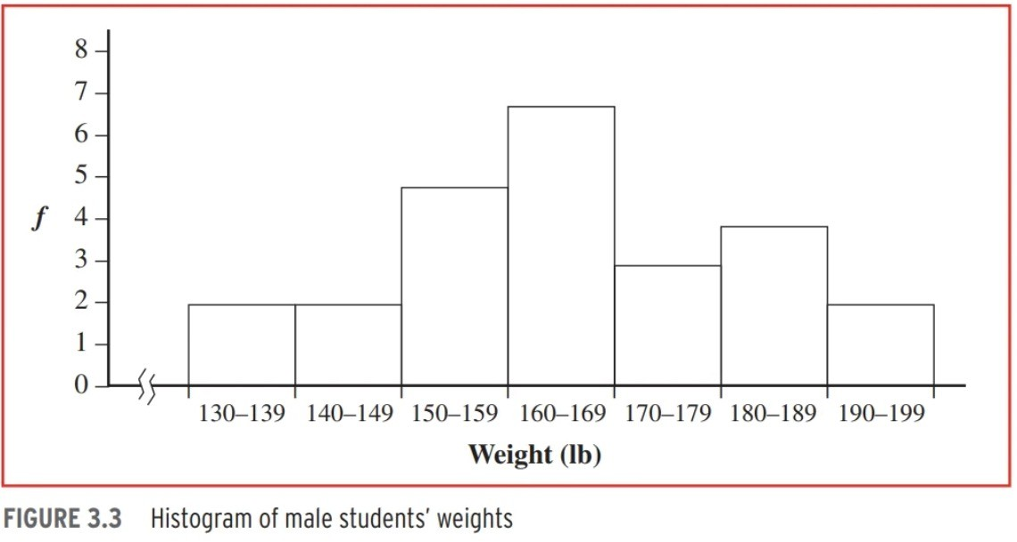
Representing grouped distributions as graphs
(ch. 3.2)
Histogram
Classes along the x-axis (horizontal), frequency along the y-axis (vertical)
Height represents frequency
NO SPACE separating the bars, no to be confused as a bar graph
Bar graphs are for nominal or ordinal data (categorical)
This is an axis break, used if scores begin a lot higher than 0. Can be used on either axis.
Convention to have y and x axes intersect at 0.
Mostly, to make graph more readable. (See Ch. 3.2)
(Hurlburt, 2017)

Slide 10
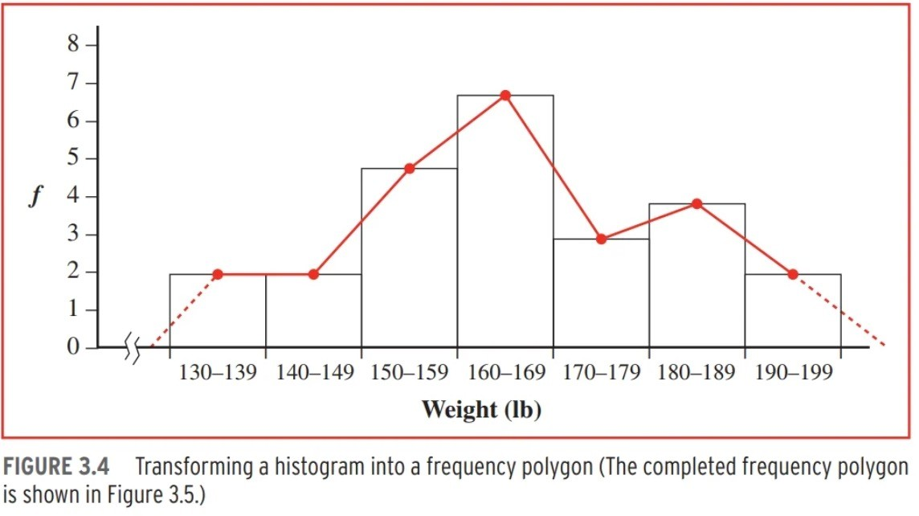
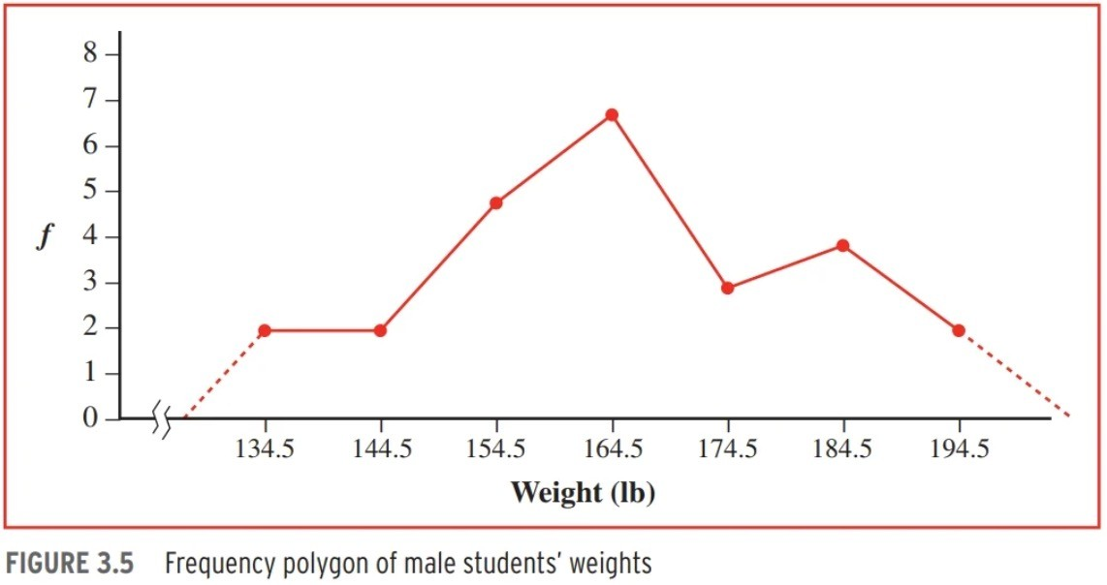
Representing grouped distributions as graphs
Frequency Polygon
Very similar to the histogram
Place each point in the ‘middle’ of the bar, and connect the lines
The middle is also called the midpoint
Don’t create both, superimposed (figure 3.4) is to illustrate how they show the same information
(Hurlburt, 2017)

Slide 11
Example of a grouped frequency distribution
# of Hours Binge-watching TV Example
Interval | Frequency | Frequency % | Cumulative Frequency %
1-2 | 7 | 10 | 0 + 10 = 10
3-4 | 29 | 41.43 | 10 + 41.33 = 51.43
5-6 | 22 | 31.42 | 51.43+ 31.42 = 82.85
7-8 | 5 | 7.14 | 82.85 + 7.14 = 89.99
9-10 | 4 | 5.71 | 89.99 + 5.71 = 95.71
11-12 | 2 | 2.85 | 95.71 + 2.85 = 98.55
13-14 | 1 | 1.42 | 98.55 + 1.42 = 99.97
15 | 0
 | n = 70
Note: if we simply add up the % frequency. We are off by 0.03%!
This is a rounding issue, since we dropped the 3rd decimal point.
How do we fix this? We will see on the next slide.

Slide 12
# of Hours Binge-watching TV Example
Interval | Frequency | Frequency % | Cumulative Frequency | Cumulative Frequency % ((cumulative frequency/n )* 100)
1-2 | 7 | 10 | 0 + 7 = 7 | (7/70)*100 = 10
3-4 | 29 | 41.43 | 7 + 29 = 36 | (36/70)*100 = 51.42
5-6 | 22 | 31.42 | 36 + 22 = 58 | (58/70)*100 = 82.85
7-8 | 5 | 7.14 | 58 + 5 = 63 | (63/70)*100 = 90
9-10 | 4 | 5.71 | 63 + 4 = 67 | (67/70)*100 = 95.71
11-12 | 2 | 2.85 | 67 + 2 = 69 | (69/70)*100 = 98.57
13-14 | 1 | 1.42 | 69 + 1 = 70 | (10/70)*100 = 100
15 | 0
 | n = 70
If we take the more precise approach (last column), we avoid compounding rounding errors at end up at exactly 100%!

Slide 13
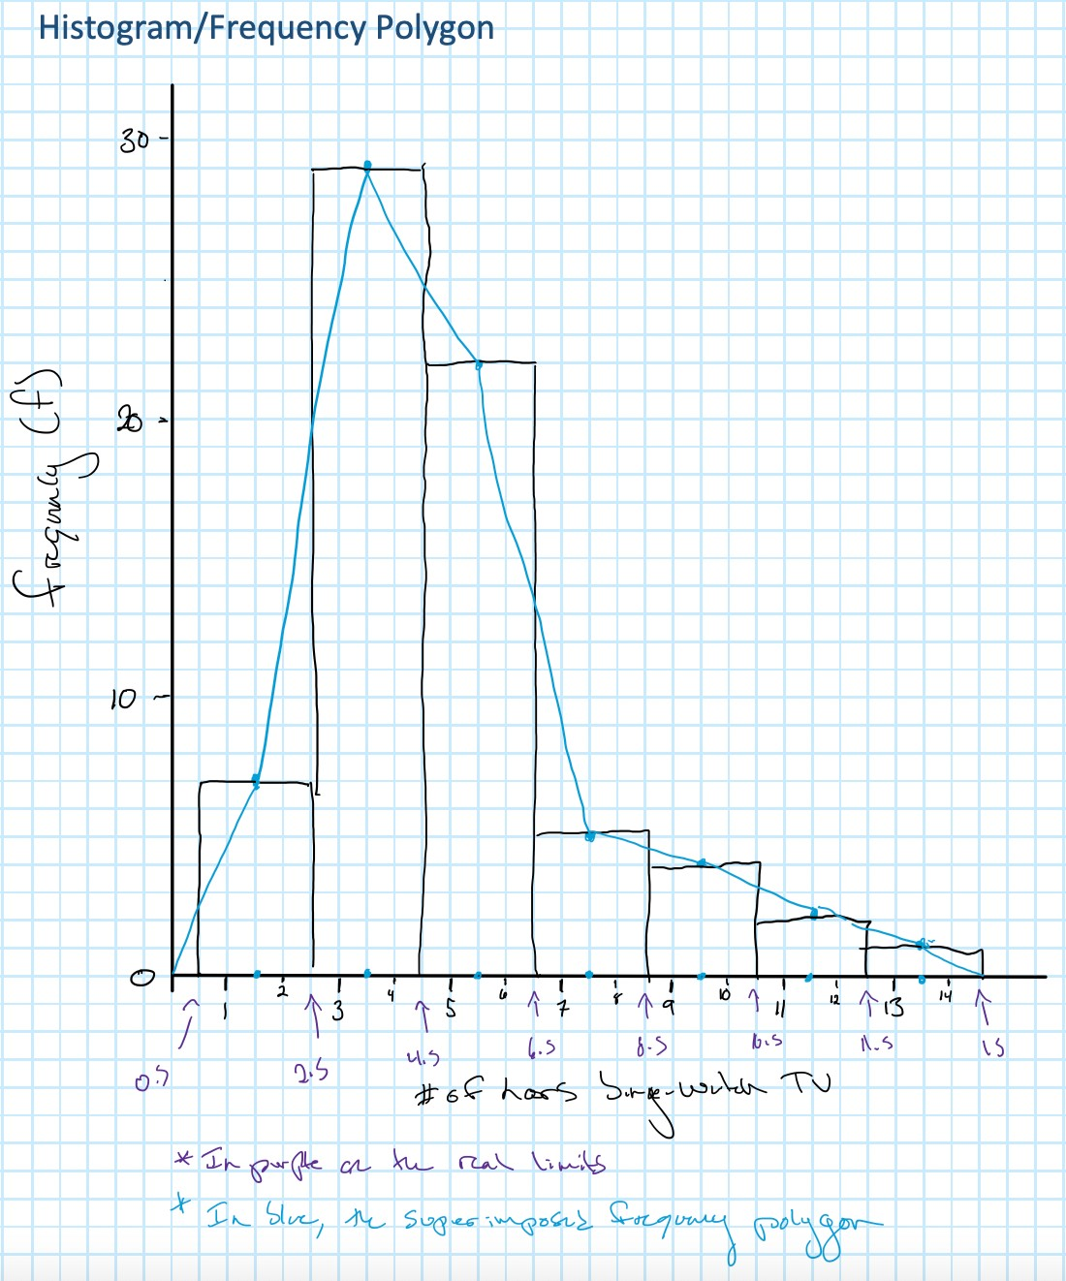

Slide 14
Shapes of Distributions
Skew
Negative skew
Long tail on the negative/left side of the distribution; bulk of scores on right side
Positive Skew
Long tail on the positive/right side of the distribution; bulk of scores on left side
Modality
How many modes (peaks) are there?
Symmetry
Are the left and right sides mirror images or each other?

Slide 15



Asymmetrical shapes

Slide 16
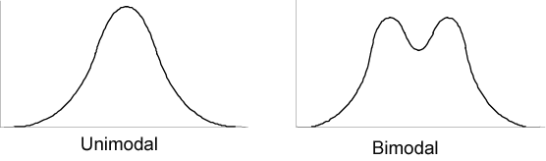
Modality (no. of peaks)

Slide 17



Symmetrical shapes

Slide 18
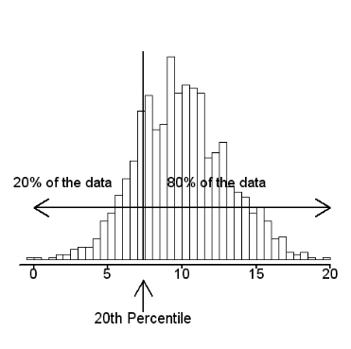
Percentiles and the Ogive Curve
Percentile is the % of all scores BELOW a certain value
30th percentile means 70% of scores are above this point
Ogive curve is a way of graphing cumulative frequencies
Always has a positive slope (grows from left to right)
Easy to interpret percentiles from

Slide 19
Percentiles & Ogive Curve

Slide 20
